Slide 1

Lightning-fast unified analytics engine

Slide 2
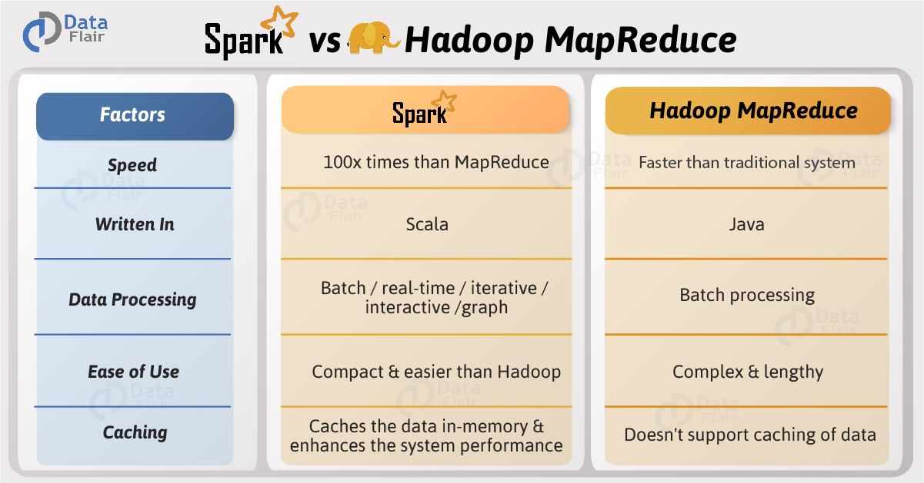
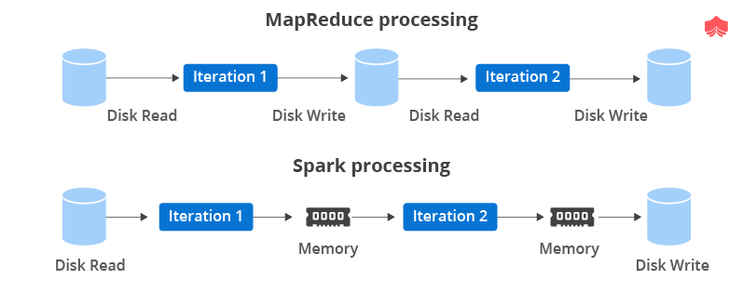

Slide 3
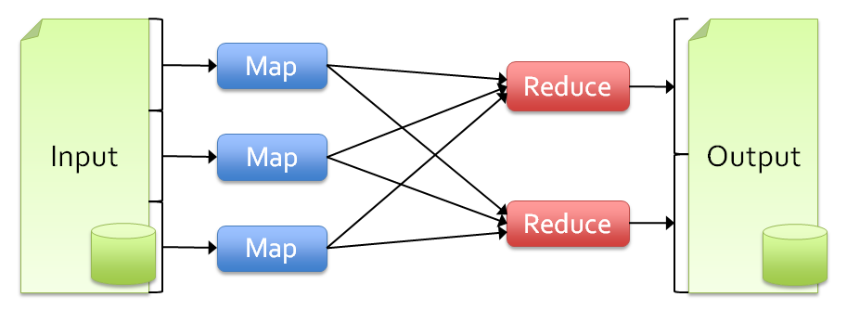
Limitations of MapReduce
As a general programming model:
It is more suitable for one-pass computation on a large dataset
Hard to compose and nest multiple operations
No means of expressing iterative operations
As implemented in Hadoop
All datasets are read from disk, then stored back on to disk
All data is (usually) triple-replicated for reliability
Not easy to write MapReduce programs using Java

Slide 4
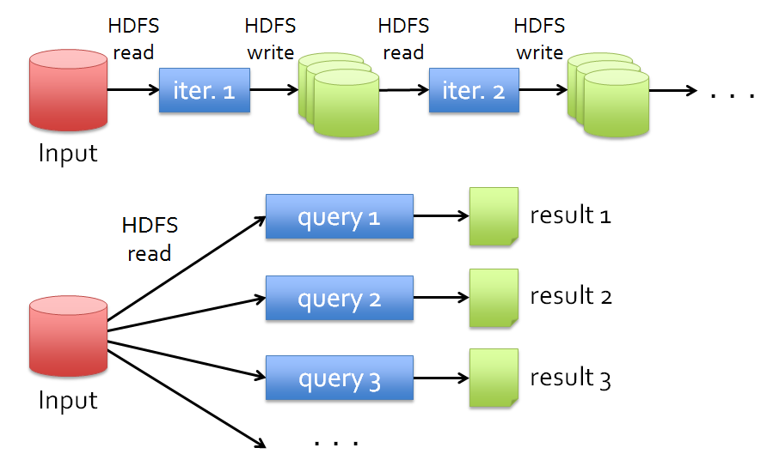
Data Sharing in MapReduce
Slow due to replication, serialization, and disk IO
Complex apps, streaming, and interactive queries all need one thing that MapReduce lacks:
Efficient primitives for data sharing

Slide 5
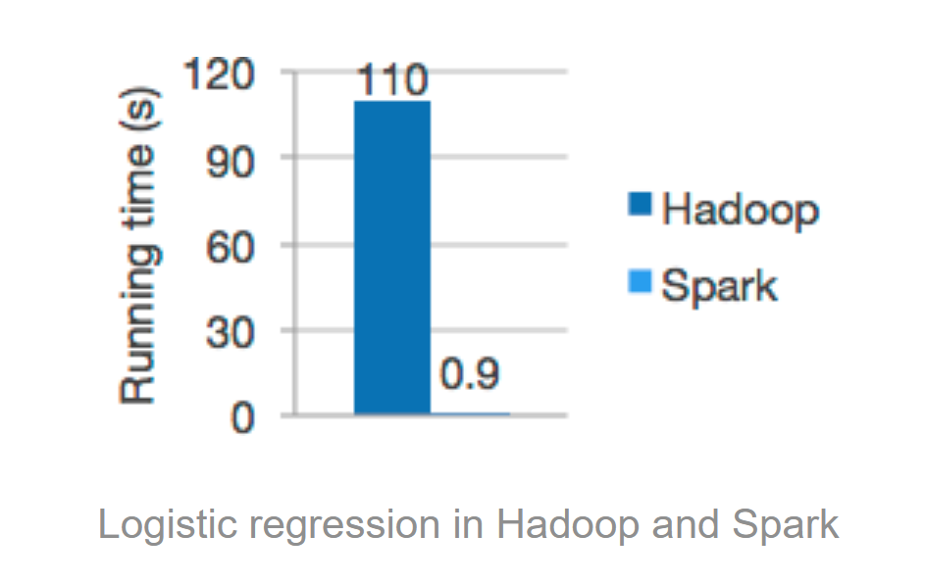
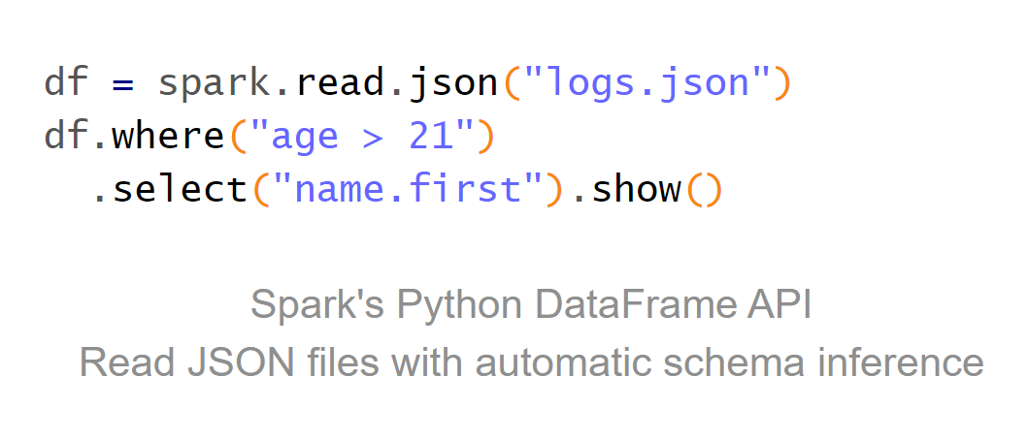
Lightning-fast unified analytics engine
Speed
Run workloads 100x faster.
Apache Spark achieves high performance for both batch and streaming data, using a state-of-the-art DAG scheduler, a query optimizer, and a physical execution engine.
Ease of Use
Write applications quickly in Java, Scala, Python, R, and SQL.
Spark offers over 80 high-level operators that make it easy to build parallel apps. And you can use it interactively from the Scala, Python, R, and SQL shells.

Slide 6
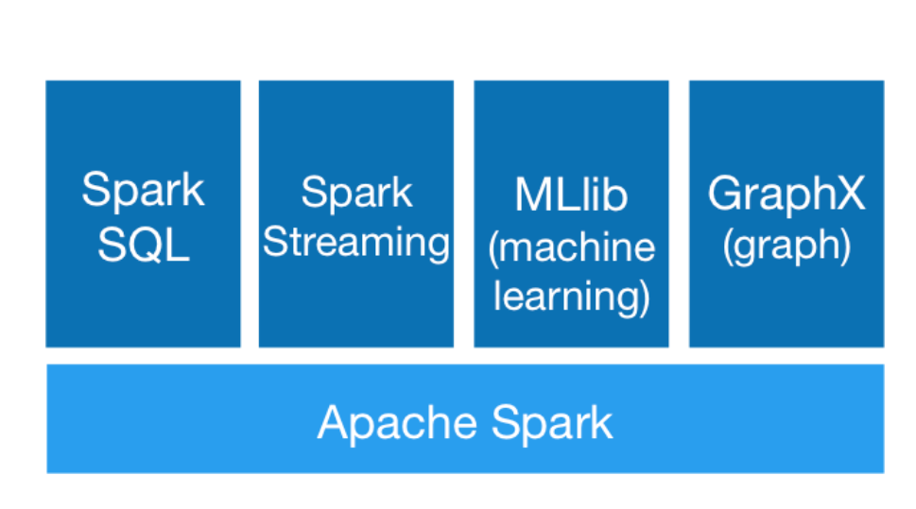
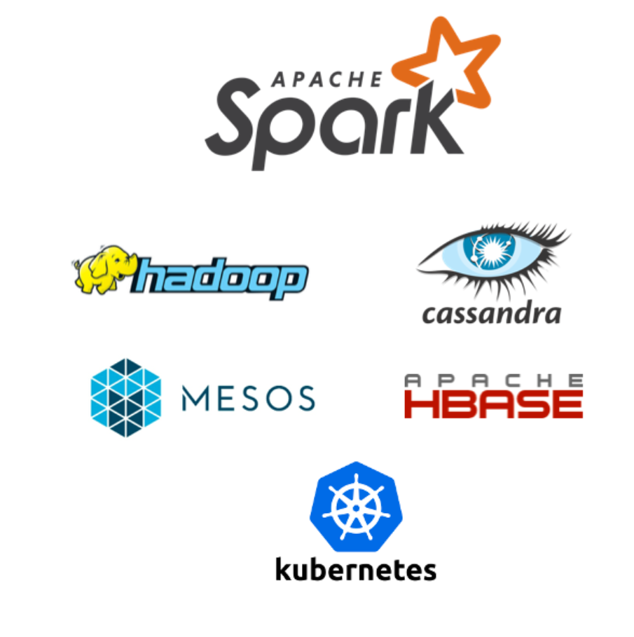
Generality
Combine SQL, streaming, and complex analytics.
Spark powers a stack of libraries including SQL and DataFrames, MLlib for machine learning, GraphX, and Spark Streaming. You can combine these libraries seamlessly in the same application.
Runs Everywhere
Spark runs on Hadoop, Apache Mesos, Kubernetes, standalone, or in the cloud. It can access diverse data sources.
You can run Spark using its standalone cluster mode, on EC2, on Hadoop YARN, on Mesos, or on Kubernetes. Access data in HDFS, Alluxio, Apache Cassandra, Apache HBase, Apache Hive, and hundreds of other data sources.

Slide 7
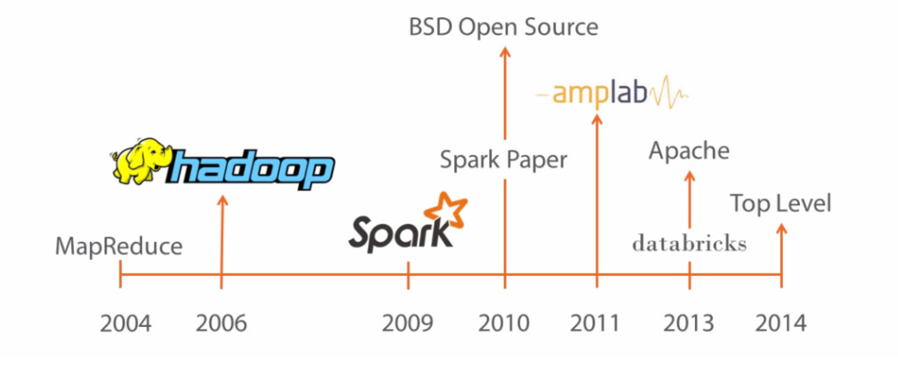
Apache Spark History
Apache Spark started as a research project at the UC Berkeley AMPLab in 2009, and was open sourced in early 2010. Many of the ideas behind the system were presented in various research papers over the years.
After being released, Spark grew into a broad developer community, and moved to the Apache Software Foundation in 2013. Today, the project is developed collaboratively by a community of hundreds of developers from hundreds of organizations.

Slide 8
What is Spark
Fast and expressive cluster computing system interoperable with Apache Hadoop
Improves efficiency through:
In-memory computing primitives
General computation graphs
Improves usability through:
Rich APIs in Scala, Java, Python
Interactive shell
Spark is not
a modified version of Hadoop
dependent on Hadoop because it has its own cluster management
Spark uses Hadoop for storage purpose only
Up to 100× faster
(2-10× on disk)
Often 5× less code

Slide 9
Spark Ideas
Expressive computing system, not limited to map-reduce model
Facilitate system memory
avoid saving intermediate results to disk
cache data for repetitive queries (e.g. for machine learning)
Layer an in-memory system on top of Hadoop.
Achieve fault-tolerance by re-execution instead of replication

Slide 10
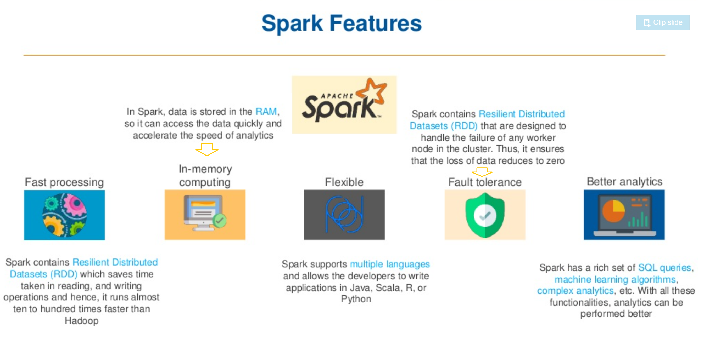

Slide 11
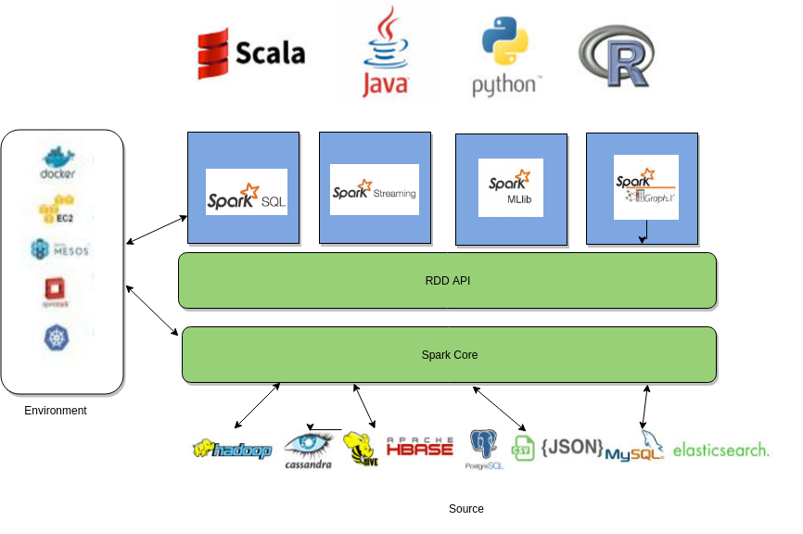
Spark ecosystem

Slide 12

Spark Components
Spark applications run as independent sets of processes on a cluster, coordinated by the SparkContext object in your main program (called the driver program).
Specifically, to run on a cluster, the SparkContext can connect to several types of cluster managers (either Spark’s own standalone cluster manager, Mesos or YARN), which allocate resources across applications. Once connected, Spark acquires executors on nodes in the cluster, which are processes that run computations and store data for your application. Next, it sends your application code (defined by JAR or Python files passed to SparkContext) to the executors. Finally, SparkContext sends tasks to the executors to run.

Slide 13
Cluster Manager Types
The system currently supports several cluster managers:
Standalone – a simple cluster manager included with Spark that makes it easy to set up a cluster.
Apache Mesos – a general cluster manager that can also run Hadoop MapReduce and service applications.
Hadoop YARN – the resource manager in Hadoop 2.
Kubernetes – an open-source system for automating deployment, scaling, and management of containerized applications.
A third-party project (not supported by the Spark project) exists to add support for Nomad as a cluster manager.
Spark Context
Main entry point for Spark functionality. A SparkContext represents the connection to a Spark cluster, and can be used to create RDDs, accumulators and broadcast variables on that cluster.
Every Spark Application needs an entry point that allows it to communicate with data sources and perform certain operations such as reading and writing data. In Spark 1.x, three entry points were introduced: SparkContext, SQLContext and HiveContext. Since Spark 2.x, a new entry point called SparkSession has been introduced that essentially combined all functionalities available in the three aforementioned contexts. Note that all contexts are still available even in newest Spark releases, mostly for backward compatibility purposes.

Slide 14
SparkContext
SparkContext is the entry point to Spark for a Spark application.
Once a SparkContext instance is created you can use it to
Create RDDs
Create accumulators
Create broadcast variables
access Spark services and run jobs
A Spark context is essentially a client of Spark’s execution environment and acts as the master of your Spark application
The first thing a Spark program must do is to create a SparkContext object, which tells Spark how to access a cluster
In the Spark shell, a special interpreter-aware SparkContext is already created for you, in the variable called sc

Slide 15
Create a SparkContext
import org.apache.spark.SparkContext
import org.apache.spark.SparkContext._
val sc = new SparkContext(“url”, “name”, “sparkHome”, Seq(“app.jar”))
Scala
Cluster URL, or local / local[N]
App name
Spark install path on cluster
List of JARs with app code (to ship)
import org.apache.spark.api.java.JavaSparkContext;
JavaSparkContext sc = new JavaSparkContext(
“masterUrl”, “name”, “sparkHome”, new String[] {“app.jar”}));
Java
from pyspark import SparkContext
sc = SparkContext(“masterUrl”, “name”, “sparkHome”, [“library.py”]))
Python
Notes:
Mention assembly JAR in Maven etc
Use the shell with your own JAR`

Slide 16
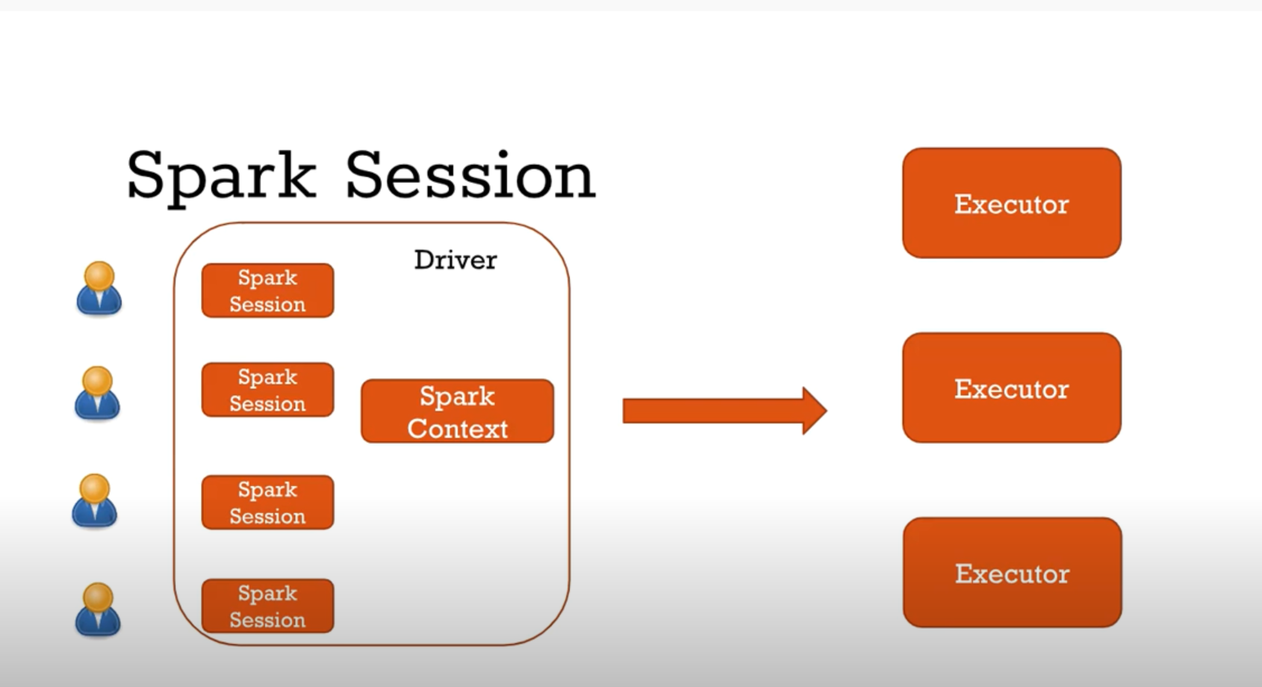
Difference between Spark Context and Spark Session
Main entry point for Spark functionality. A SparkContext represents the connection to a Spark cluster, and can be used to create RDDs, accumulators and broadcast variables on that cluster.
Only one SparkContext may be active per JVM. You must stop() the active SparkContext before creating a new one. This limitation may eventually be removed
Why I need Spark Session ?
Every user wants his own
Set of properties
Own Sets of Tables
Cluster is shared from resources point of view

Slide 17
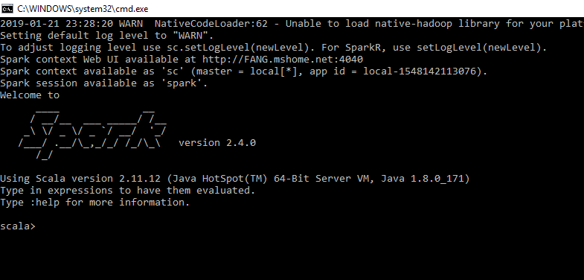

Slide 18
Challenge
Existing Systems
Existing in-memory storage systems have interfaces based on fine-grained updates
Reads and writes to cells in a table
E.g., databases, key-value stores, distributed memory
Requires replicating data or logs across nodes for fault tolerance
-> expensive!
10-100x slower than memory write
How to design a distributed memory abstraction that is both fault-tolerant and efficient?

Slide 19
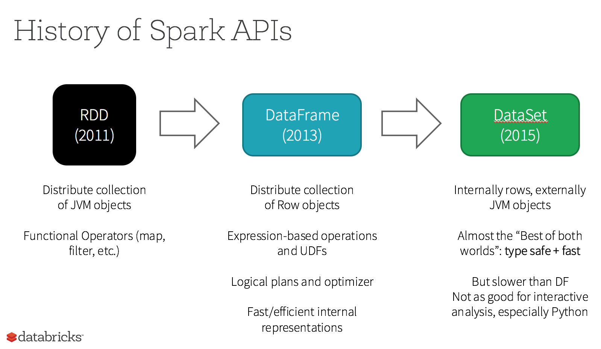

Slide 20
Solution: Resilient Distributed Datasets
Resilient Distributed Datasets (RDDs)
Distributed collections of objects that can be cached in memory across cluster
Manipulated through parallel operators
Automatically recomputed on failure based on lineage
RDDs can express many parallel algorithms, and capture many current programming models
Data flow models: MapReduce, SQL, …
Specialized models for iterative apps: Pregel, …

Slide 21
What is RDD
Resilient Distributed Datasets: A Fault-Tolerant Abstraction for In-Memory Cluster Computing. Matei Zaharia, et al. NSDI’12
RDD is a distributed memory abstraction that lets programmers perform in-memory computations on large clusters in a fault-tolerant manner.
Resilient
Fault-tolerant, is able to recompute missing or damaged partitions due to node failures.
Distributed
Data residing on multiple nodes in a cluster.
Dataset
A collection of partitioned elements, e.g. tuples or other objects (that represent records of the data you work with).
RDD is the primary data abstraction in Apache Spark and the core of Spark. It enables operations on collection of elements in parallel.

Slide 22
RDD Traits
In-Memory, i.e. data inside RDD is stored in memory as much (size) and long (time) as possible.
Immutable or Read-Only, i.e. it does not change once created and can only be transformed using transformations to new RDDs.
Lazy evaluated, i.e. the data inside RDD is not available or transformed until an action is executed that triggers the execution.
Cacheable, i.e. you can hold all the data in a persistent "storage" like memory (default and the most preferred) or disk (the least preferred due to access speed).
Parallel, i.e. process data in parallel.
Typed, i.e. values in a RDD have types, e.g. RDD[Long] or RDD[(Int, String)].
Partitioned, i.e. the data inside a RDD is partitioned (split into partitions) and then distributed across nodes in a cluster (one partition per JVM that may or may not correspond to a single node).

Slide 23
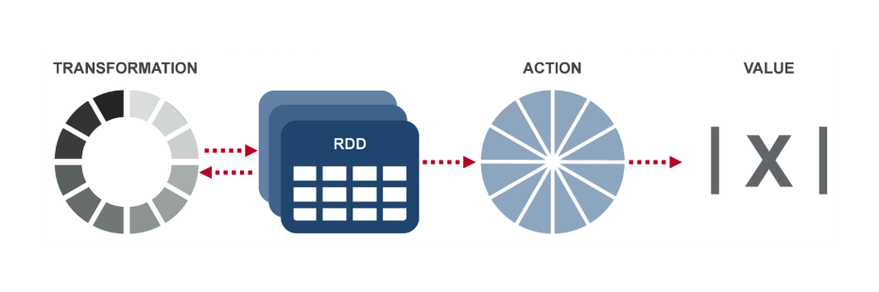
RDD Operations
Transformation: returns a new RDD.
Nothing gets evaluated when you call a Transformation function, it just takes an RDD and return a new RDD.
Transformation functions include map, filter, flatMap, groupByKey, reduceByKey, aggregateByKey, filter, join, etc.
Action: evaluates and returns a new value.
When an Action function is called on a RDD object, all the data processing queries are computed at that time and the result value is returned.
Action operations include reduce, collect, count, first, take, countByKey, foreach, saveAsTextFile, etc.

Slide 24
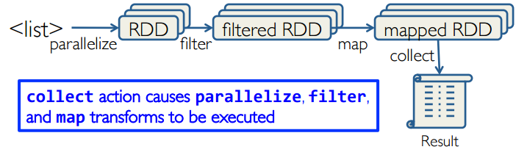
Working with RDDs
Create an RDD from a data source
by parallelizing existing Python collections (lists)
by transforming an existing RDDs
from files in HDFS or any other storage system
Apply transformations to an RDD: e.g., map, filter
Apply actions to an RDD: e.g., collect, count
Users can control two other aspects:
Persistence
Partitioning

Slide 25
Creating RDDs
From HDFS, text files, Amazon S3, Apache HBase, SequenceFiles, any other Hadoop InputFormat
Creating an RDD from a File
val inputfile = sc.textFile("...", 4)
RDD distributed in 4 partitions
Elements are lines of input
Lazy evaluation means no execution happens now
Turn a Python collection into an RDD
sc.parallelize([1, 2, 3]), creating from a Python list
Creating an RDD from an existing Hadoop InputFormat
sc.hadoopFile(keyClass, valClass, inputFmt, conf)

Slide 26
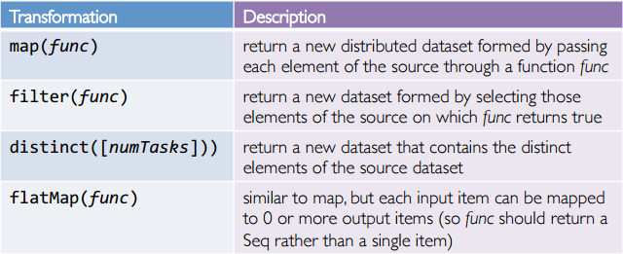
Spark Transformations
Create new datasets from an existing one
Use lazy evaluation: results not computed right away – instead Spark remembers set of transformations applied to base dataset
Spark optimizes the required calculations
Spark recovers from failures
Some transformation functions

Slide 27
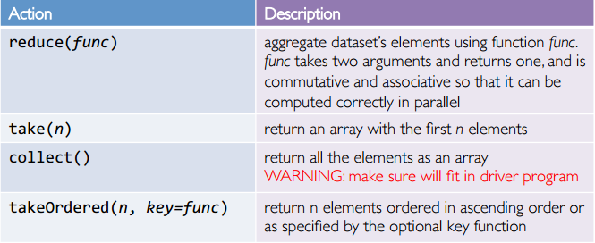
Spark Actions
Cause Spark to execute recipe to transform source
Mechanism for getting results out of Spark
Some action functions
Example: words.collect().foreach(println)

Slide 28
Example
Web service is experiencing errors and an operators want to search terabytes of logs in the Hadoop file system to find the cause.
Line1: RDD backed by an HDFS file (base RDD lines not loaded in memory)
Line3: Asks for errors to persist in memory (errors are in RAM)
//base RDD
val lines = sc.textFile(“hdfs://…”)
//Transformed RDD
val errors = lines.filter(_.startsWith(“Error”))
errors.persist()
errors.count()
errors.filter(_.contains(“HDFS”))
.map(_split(‘\t’)(3))
.collect()

Slide 29
Lineage Graph
RDDs keep track of lineage
RDD has enough information about how it was derived from to compute its partitions from data in stable storage.
Example:
If a partition of errors is lost, Spark rebuilds it by applying a filter on only the corresponding partition of lines.
Partitions can be recomputed in parallel on different nodes, without having to roll back the whole program.
RDD1
RDD2
RDD3
RDD4

Slide 30
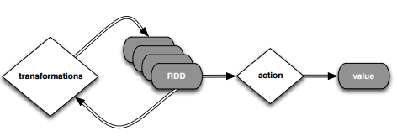
Deconstructed
//base RDD
val lines = sc.textFile(“hdfs://…”)
//Transformed RDD
val errors = lines.filter(_.startsWith(“Error”))
errors.persist()
errors.count()
errors.filter(_.contains(“HDFS”))
.map(_split(‘\t’)(3))
.collect()

Slide 31
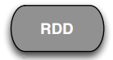
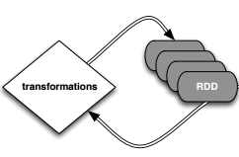
Deconstructed
//base RDD
val lines = sc.textFile(“hdfs://…”)
//Transformed RDD
val errors = lines.filter(_.startsWith(“Error”))
errors.persist()
errors.count()
count() causes Spark to: 1) read data; 2) sum within partitions; 3) combine sums in driver
Put transform and action together: errors.filter(_.contains(“HDFS”)).map(_split(‘\t’)(3)).collect()

Slide 32
RDD Persistence: Cache/Persist
One of the most important capabilities in Spark is persisting (or caching) a dataset in memory across operations.
When you persist an RDD, each node stores any partitions of it. You can reuse it in other actions on that dataset
Each persisted RDD can be stored using a different storage level, e.g.
MEMORY_ONLY:
Store RDD as deserialized Java objects in the JVM.
If the RDD does not fit in memory, some partitions will not be cached and will be recomputed when they're needed.
This is the default level.
MEMORY_AND_DISK:
If the RDD does not fit in memory, store the partitions that don't fit on disk, and read them from there when they're needed.
cache() = persist(StorageLevel.MEMORY_ONLY)

Slide 33
Why Persisting RDD?
val lines = sc.textFile(“hdfs://…”)
val errors = lines.filter(_.startsWith(“Error”))
errors.persist()
errors.count()
If you do errors.count() again, the file will be loaded again and computed again.
Persist will tell Spark to cache the data in memory, to reduce the data loading cost for further actions on the same data
erros.persist() will do nothing. It is a lazy operation. But now the RDD says "read this file and then cache the contents". The action will trigger computation and data caching.

Slide 34
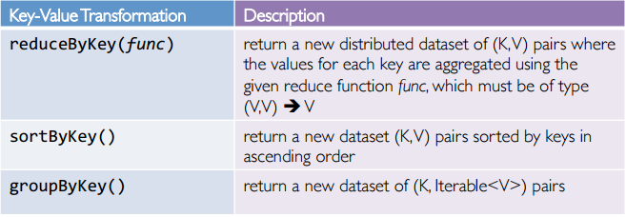
Spark Key-Value RDDs
Similar to Map Reduce, Spark supports Key-Value pairs
Each element of a Pair RDD is a pair tuple
Some Key-Value transformation functions:

Slide 35
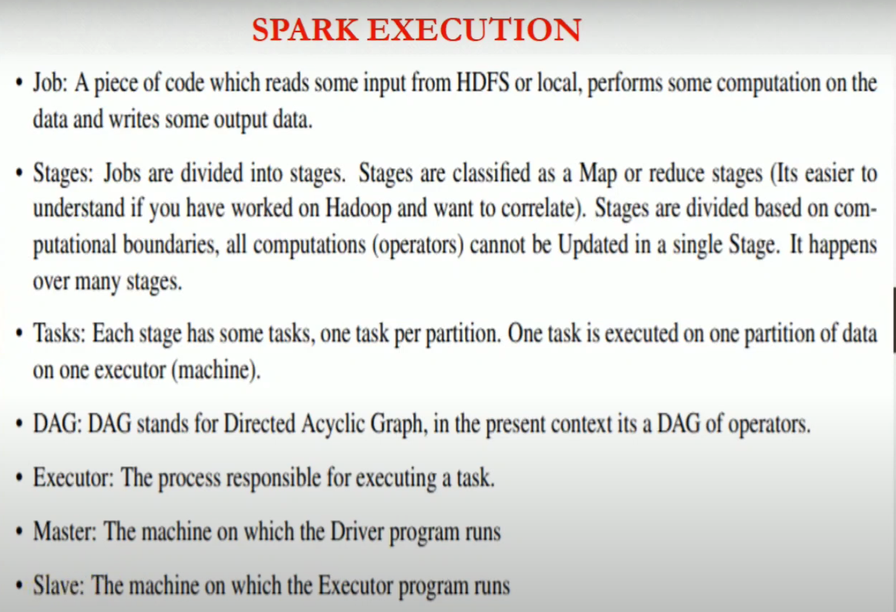

Slide 36
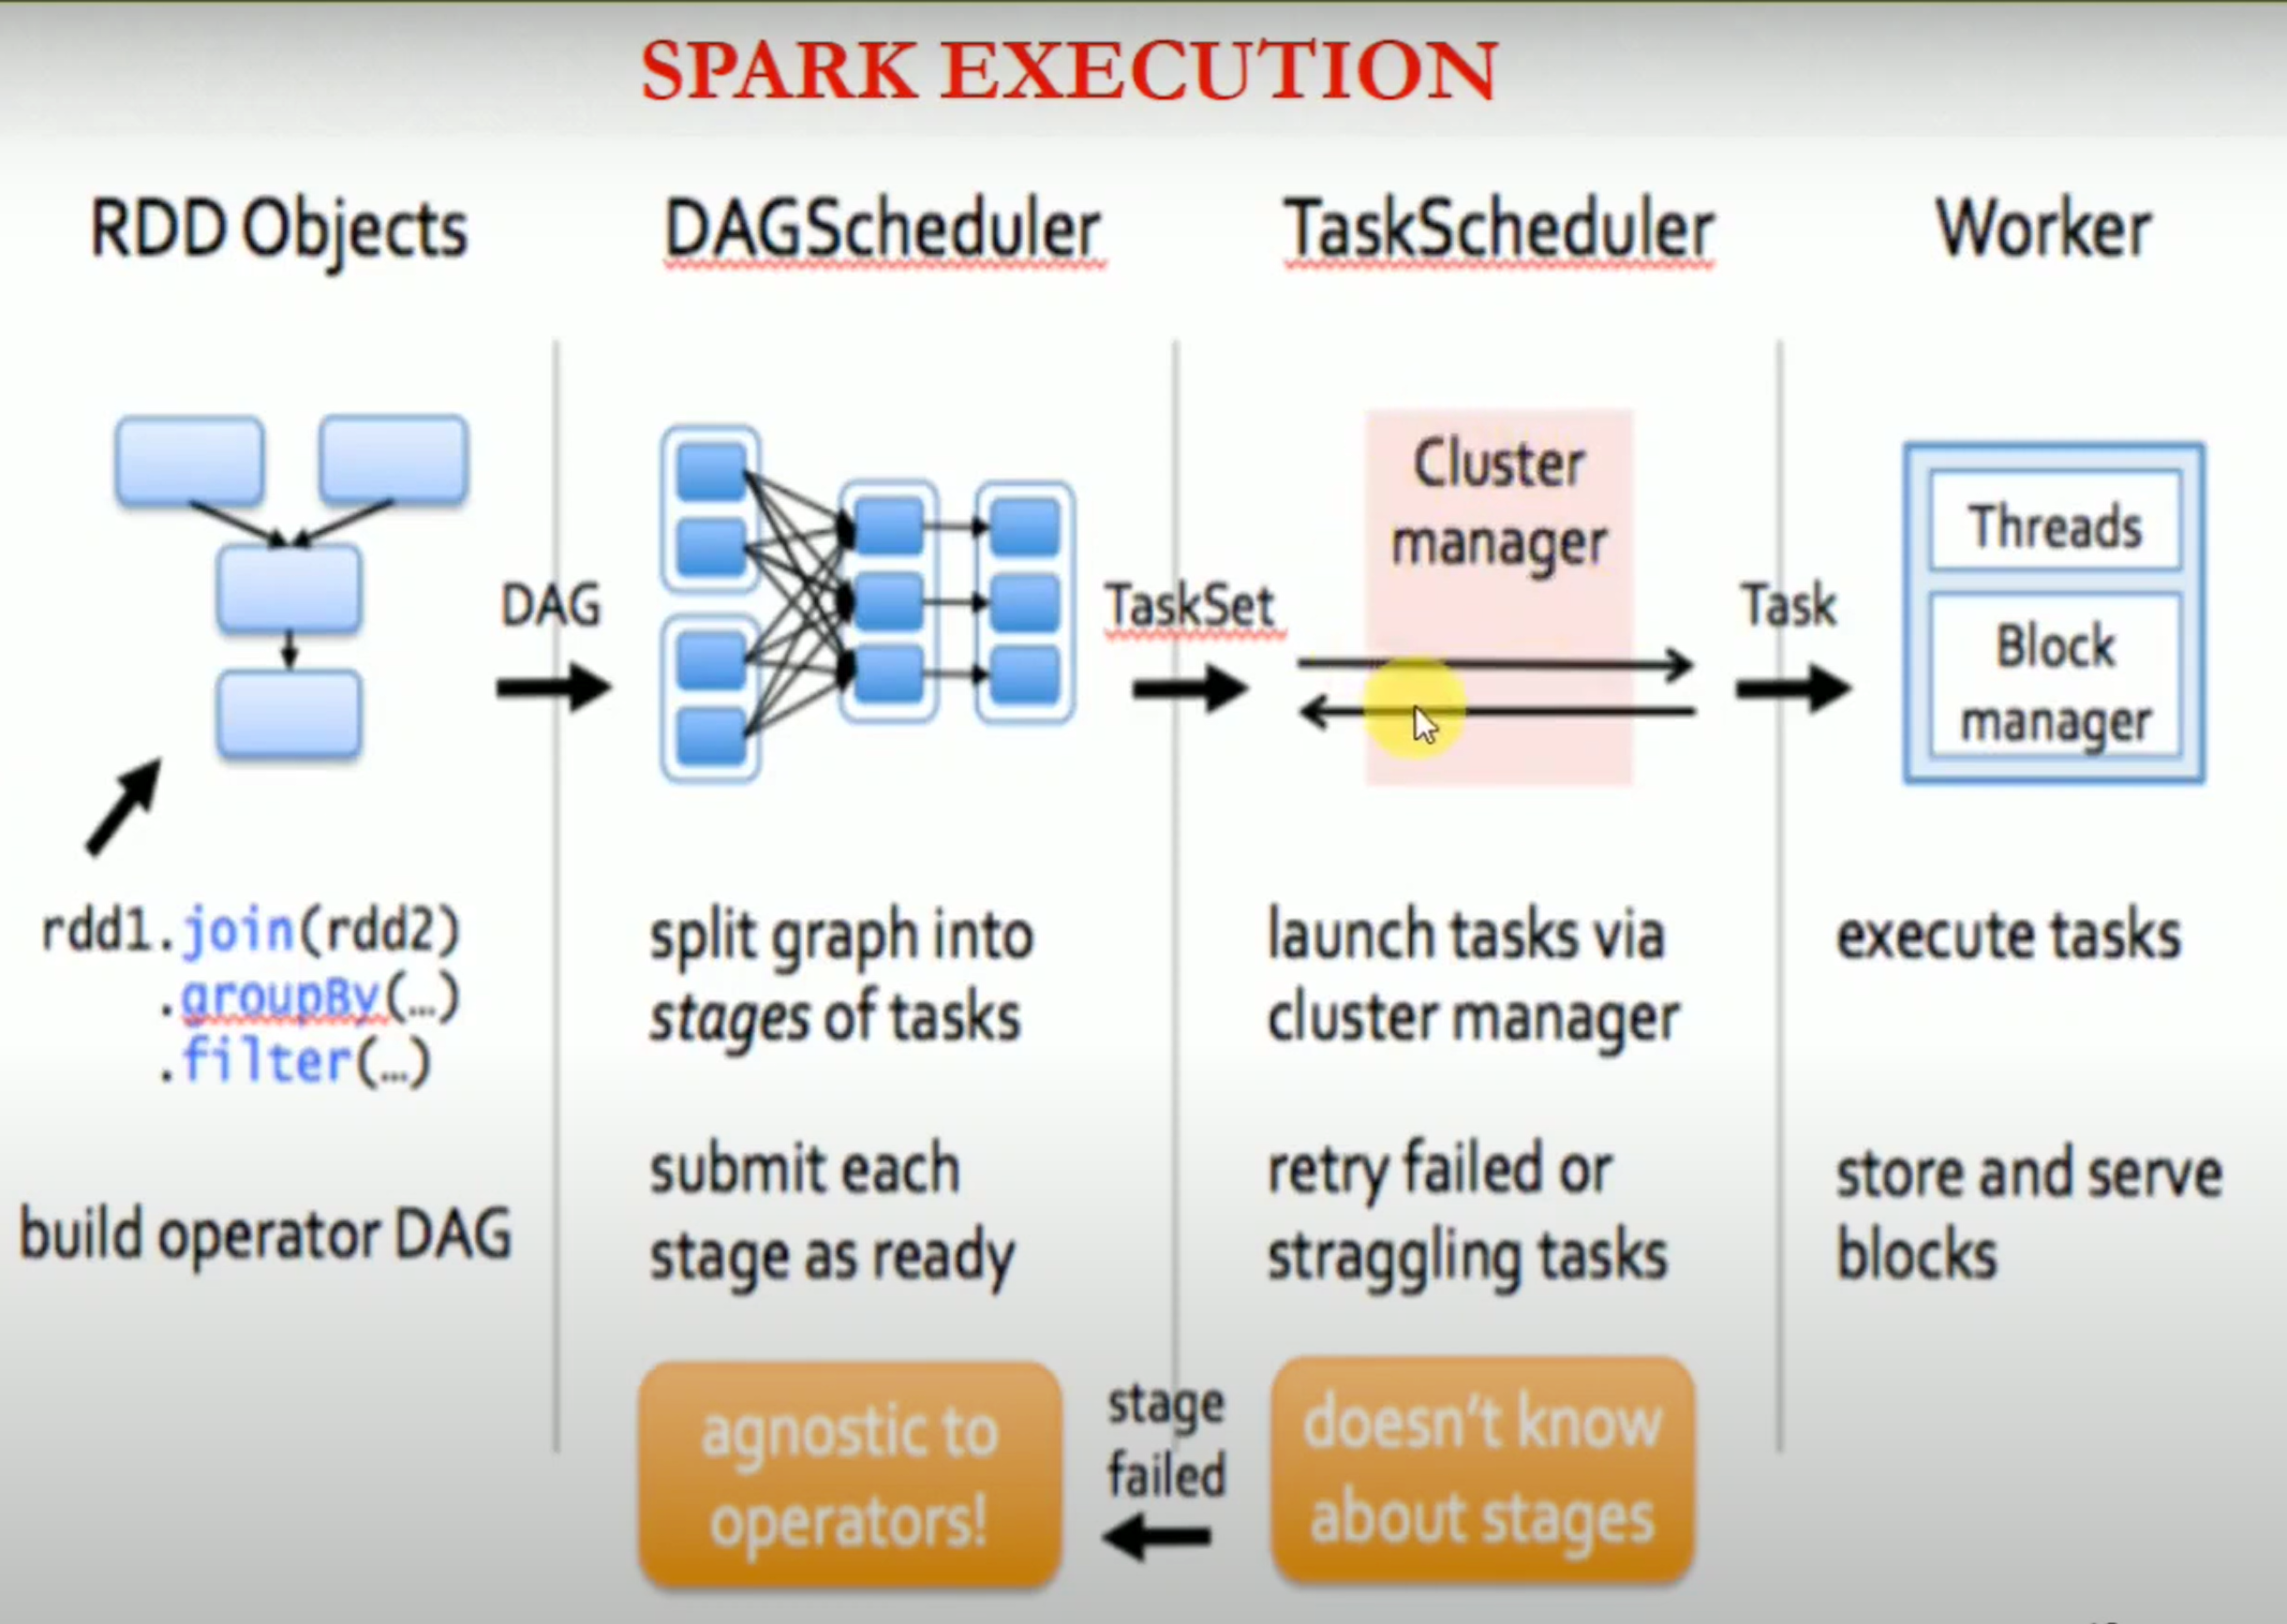

Slide 37
How Spark Works
User application create RDDs, transform them, and run actions.
This results in a DAG (Directed Acyclic Graph) of operators.
DAG is compiled into stages
Each stage is executed as a series of Task (one Task for each Partition).

Slide 38
Word Count in Spark
val file = sc.textFile(“hdfs://…”, 4)
RDD[String]
textFile

Slide 39
Word Count in Spark
val file = sc.textFile(“hdfs://…”, 4)
val words = file.flatMap(line => line.split(“\t”))
RDD[String]
RDD[List[String]]
textFile
flatMap

Slide 40
Word Count in Spark
val file = sc.textFile(“hdfs://…”, 4)
val words = file.flatMap(line => line.split(“\t”))
val pairs = words.map(t => (t, 1))
RDD[String]
RDD[List[String]]
RDD[(String, Int)]
textFile
flatMap
map

Slide 41
Word Count in Spark
val file = sc.textFile(“hdfs://…”)
val words = file.flatMap(line => line.split(“\t”))
val pairs = words.map(t => (t, 1))
val count = pairs. reduceByKey(_+_)
RDD[String]
RDD[List[String]]
RDD[(String, Int)]
RDD[(String, Int)]
textFile
flatMap
map
reduceByKey

Slide 42
Word Count in Spark
val file = sc.textFile(“hdfs://…”, 4)
val words = file.flatMap(line => line.split(“\t”))
val pairs = words.map(t => (t, 1))
val count = pairs. reduceByKey(_+_)
count.collect()
RDD[String]
RDD[List[String]]
RDD[(String, Int)]
RDD[(String, Int)]
Array[(String, Int)]
collect
textFile
flatMap
map
reduceByKey

Slide 43
Execution Plan
Stage 1
Stage 2
collect
textFile
flatMap
map
reduceByKey
The scheduler examines the RDD’s lineage graph to build a DAG of stages.
Stages are sequences of RDDs, that don’t have a Shuffle in between
The boundaries are the shuffle stages.

Slide 44
Execution Plan
Stage 1
Stage 2
collect
textFile
flatMap
map
reduceByKey
Read HDFS split
Apply both the maps
Start Partial reduce
Write shuffle data
Read shuffle data
Final reduce
Send result to driver program
Stage 1
Stage 2

Slide 45
Stage Execution
Task 1
Task 2
Task 2
Task 2
Create a task for each Partition in the new RDD
Serialize the Task
Schedule and ship Tasks to Slaves
All this happens internally

Slide 46
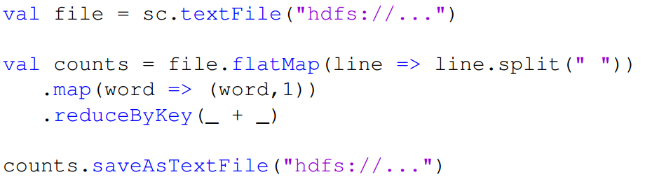
Word Count in Spark (As a Whole View)
Transformation
Word Count using Scala in Spark
Action
“to” “be” “or”
(to, 1) (be, 1) (or, 1)
(be, 2) (not, 1)
“to be or”
“not” “to” “be”
(not, 1) (to, 1) (be, 1)
“not to be”
(or, 1)
(to, 2)

Slide 47
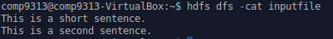
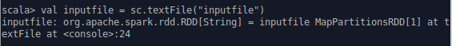
map vs. flatMap
Sample input file:
map: Return a new distributed dataset formed by passing each element of the source through a function func.
flatMap: Similar to map, but each input item can be mapped to 0 or more output items (so func should return a Seq rather than a single item).

Slide 48
RDD Operations

Slide 49
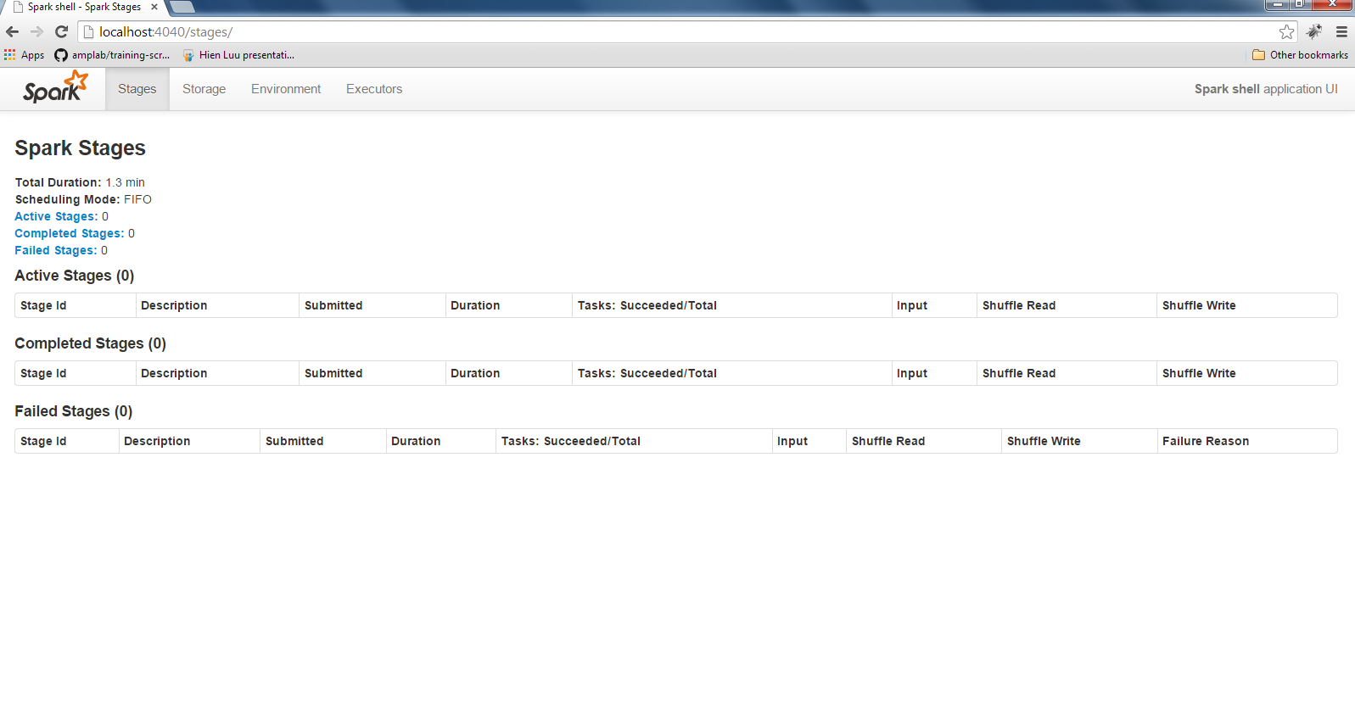
Spark Web Console

